Slide 1
Employee Data Analysis using Excel
STUDENT NAME:JAGADISH KUMAR S
REGISTER NO:312207293
NAAN MUDHALVAN ID :0D371B85D97C4D286C945298DA529765
DEPARTMENT:B.COM (GENERAL)
COLLEGE: C KANDASWAMI NAIDU COLLEGE FOR MEN

Slide 2
PROJECT TITLE
Department (Count) Analysis using Excel Modeling

Slide 3


AGENDA
Problem Statement
Project Overview
End Users
Our Solution and Proposition
Dataset Description
Modelling Approach
Results and Discussion
Conclusion
3/21/2024 Annual Review

Slide 4

PROBLEM STATEMENT
The organization needs to optimize its workforce distribution across various departments. The current employee distribution data shows significant variations, with some departments being overstaffed while others may be understaffed or have missing data (e.g., the "NULL" category).
Key Issues Identified:
Imbalance in Department Sizes: Some departments like Business Development have a higher employee count (21 employees) compared to others, such as Sales (9 employees) and Human Resources (10 employees), indicating a potential imbalance in workforce allocation.
Unspecified Employee Data: The "NULL" category (7 employees, 4%) represents entries with missing or undefined department information, which may impact data accuracy and decision-making.
Resource Allocation and Efficiency: Identifying if the current employee distribution aligns with organizational goals and operational needs. For instance, departments like Accounting and Training have similar high employee counts (18 employees each), which may or may not be justified based on their workload or strategic importance.
Objective:
To analyze and address the disparities in employee distribution across departments, ensuring optimal workforce allocation aligned with the organization’s operational requirements and strategic goals, while improving data accuracy by resolving the "NULL" entries.

Slide 5

PROJECT OVERVIEW
This project will analyzing and evaluating employees performance across various departments such as Human resources, marketing, Acconting, services, research and development, Legal, Support, Engineering.This project includes graphs and pie chart and this project will result in a comprehensive, user-friendly excel tool that can be regularly updated and used by HR and management to drive performance improvemets within the organistion.
.

Slide 6

WHO ARE THE END USERS?
Employees:
Individual Employees May have access to their performance data and metrics to self-assess and identify areas for personal improvement.
Business Organization:
Business Organization and Analysts Use the data to support performance reviews, identify training needs, and develop employee development plans.Recruitment Teams Analyze data to understand the skills and performance trends that are beneficial for hiring.

Slide 7

OUR SOLUTION AND ITS VALUE PROPOSITION
1. Comprehensive Visualization:
Using both pie charts and bar graphs allows stakeholders to quickly grasp the department sizes and proportions, facilitating immediate understanding of resource allocation.
The dual representation (percentage and absolute count) offers insights into both the relative and actual scales of each department, which is crucial for strategic planning.
2. Actionable Insights:
By highlighting departments with the highest and lowest employee counts, we help identify areas of overstaffing or understaffing. This could drive decisions about hiring, training, or restructuring to optimize productivity.
The identification of the "NULL" or unspecified group suggests a gap in data quality, prompting an opportunity for improving data collection practices.
3. Customizable Analysis:
Our approach offers flexibility: whether a department wants a quick visual overview or a deep dive into the specifics (like analyzing trends over time, or understanding correlations between department size and performance), we cater to those needs.
Integrating advanced analytics techniques like trend analysis, clustering, or even predictive modeling can forecast future department growth or contractions, providing a proactive edge.
4. Data-Driven Decision Support:
Our model empowers decision-makers by providing reliable, data-backed insights. This helps in optimizing resource distribution, planning budgets, and aligning organizational strategy with workforce dynamics.
Potential to integrate further data points (like employee performance, revenue contribution, etc.) into the model to build a holistic view of the organization's strengths and areas for improvement.
5. Enhanced Communication:
Visualization tools improve internal communication, making complex data easy to understand for

Slide 8
Dataset Description
The dataset for employee performance analysis typically includes various metrics that reflect
an employee's productivity, quality of work, attendance, and overall contribution to the
organization. Below is a description of the key columns that would be included in a Actionable Insights which Include recommendations or action items based on the analysis, such as training needs or performance improvement plans.
Excel dataset:
EmpID: A unique identifier for each employee.
Employee Name: The employee’s given name.
Gender Code: A code representing the gender of the employee (e.g., M for Male, F for Female, etc.)
Business Unit: The department or division within the company where the employee works.
Employee Salary: The amount of salary that the empoyee gets for their work.
Employee Type: Classification of the employee, such as full-time, part-time, contractor, etc.
Employee location: Location of the employee where he works.

Slide 9

THE "WOW" IN OUR SOLUTION
wow" features combine to create a powerful,
efficient, and intuitive Excel-based solution that
not only meets but exceeds expectations in
managing and analyzing employee
Performance. The solution includes an AI-driven feature that suggests actionable improvements based on performance trends, helping managers to implement effective strategies for boosting productivity and employee engagement. To improvement. This holistic view promotes better strategic decision-making.
3/21/2024 Annual Review

Slide 10
MODELLING
1.Visualization: Use pie charts and bar graphs to represent the count and percentage of employees in each department. This will provide a clear visual representation of the distribution.
2.Data Segmentation: Segment the data based on employee count ranges (e.g., high, medium, low) to identify departments with the highest and lowest employee distributions.
3.Statistical Analysis: Perform basic statistical analyses like mean, median, and mode of employee distribution to understand the central tendency and spread.

Slide 11
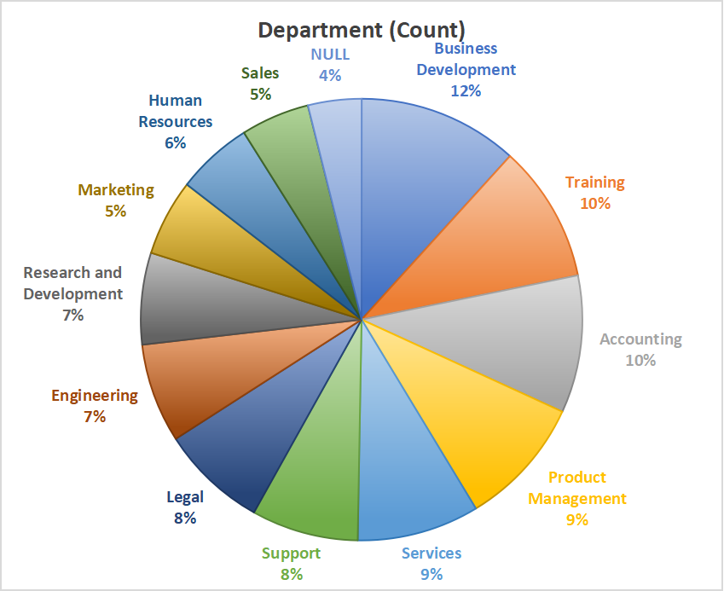
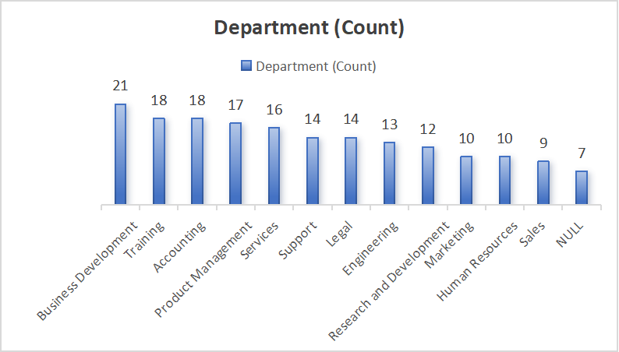
RESULTS
The charts show the distribution of employees across various departments:
Highest: Business Development (21 employees, 12%)
Training: 18 employees (10%)
Accounting: 18 employees (10%)
Product Management: 17 employees (9%)
Services: 16 employees (9%)
Support: 15 employees (8%)
Legal: 14 employees (8%)
Engineering: 13 employees (7%)
Research and Development: 12 employees (7%)
Human Resources: 10 employees (6%)
Marketing: 10 employees (5%)
Sales: 9 employees (5%)
Lowest: NULL (Unspecified) (7 employees, 4%)

Slide 12
conclusion
This Excel-based approach provides a scalable, adaptable, and efficient method for enhancing employee performance management.By leveraging data analytics, the organization can foster a culture of continuous improvement and drive overall success.Implemented an Excel-based solution for systematic employee performance analysis.Addressed the lack of consistency in evaluating performance, leading to more informed decision-making.Enabled identification of top performers, areas needing support, and overall productivity trends.Enhanced data-driven insights for management and HR.Streamlined reporting processes and reduced manual effort.Improved employee engagement and targeted development strategies.Regular updates and refinements to the model based on feedback.Integration with other data sources for a more holistic view.Continuous training for end-users to maximize tool effectiveness.

